Slide 1
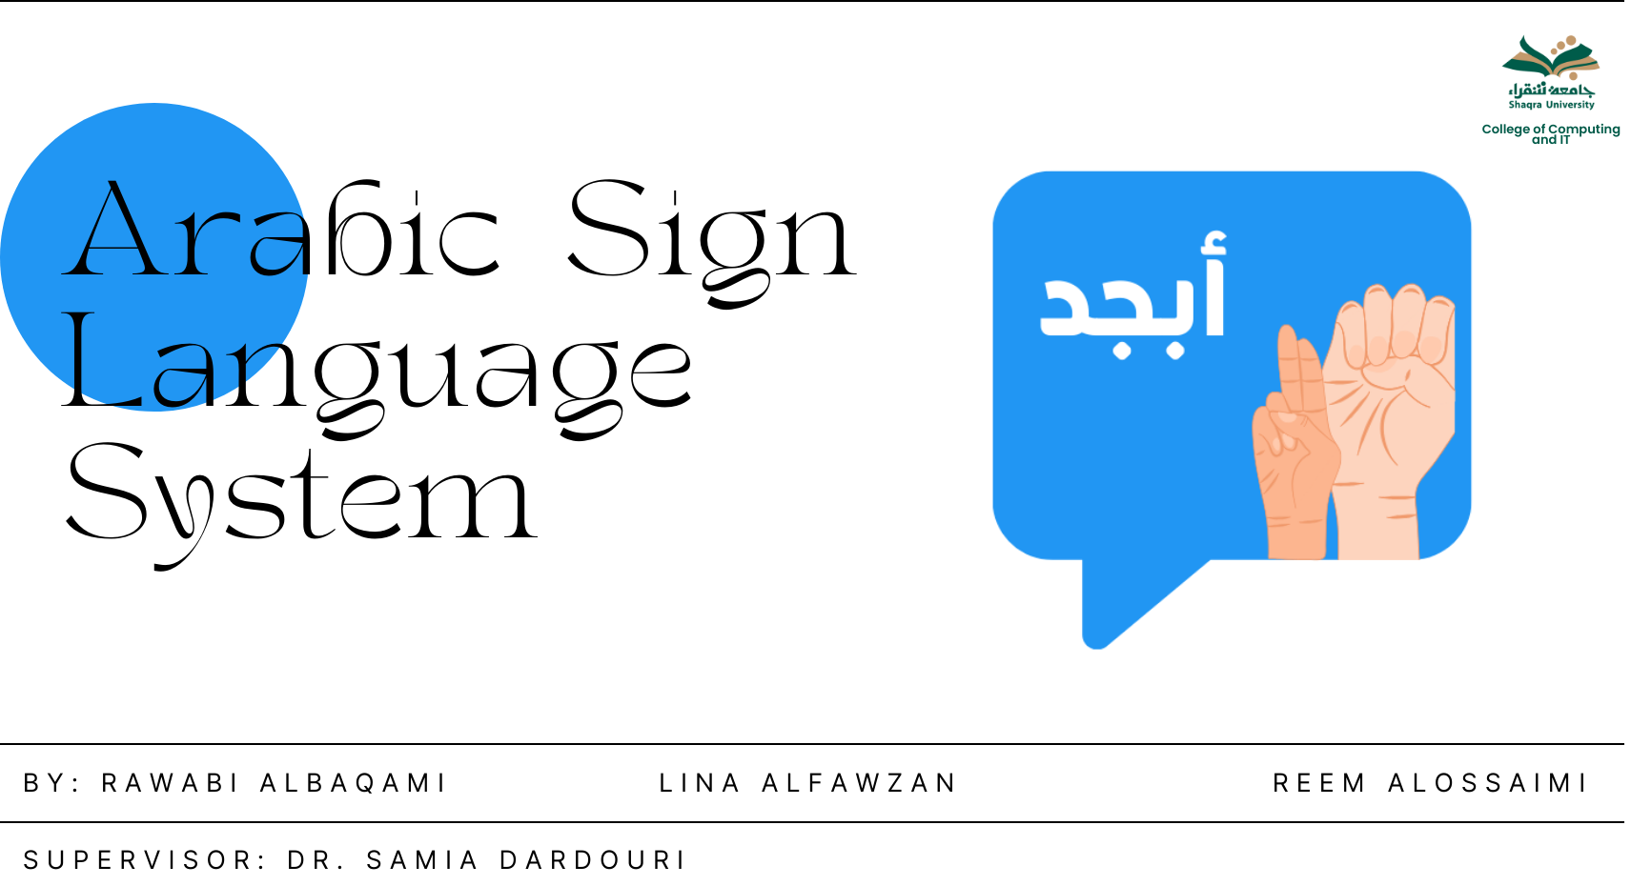
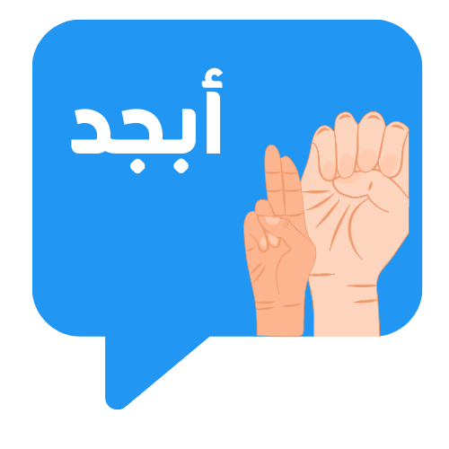

Arabic Sign Language System

Slide 2


Slide 4
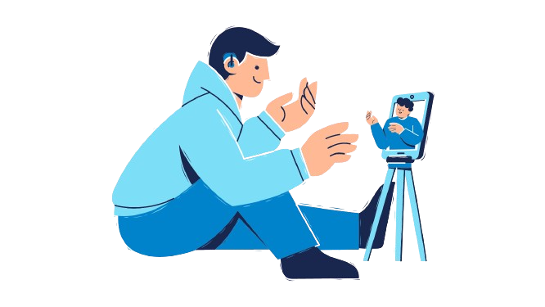
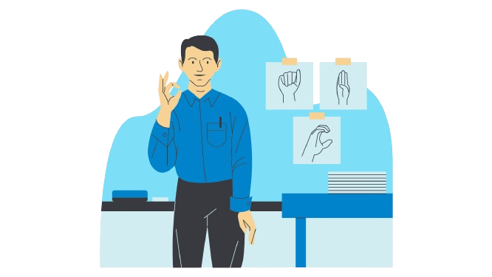
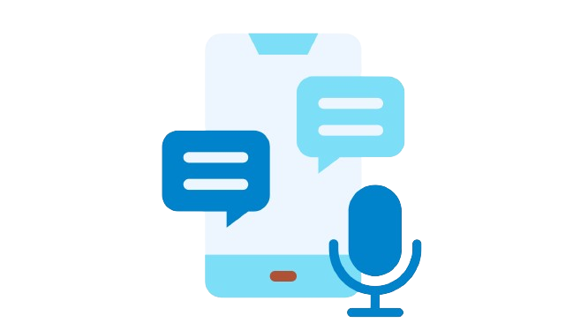
01
02
Content
03
04
Dictionary
ArSL to text
Text/voice to ArSL
Implementation

Slide 5
01
Introduction
02
Objectives
03
Conceptual Diagrams
04
Prototype

Slide 6
Sign languages enable communication for individuals with disabilities through hand movements. However, the limited knowledge of sign languages hampers effective communication. To address this, "Esharah Wahdah" aims to develop an automated Sign Language Recognition (SLR) system. This system translates sign language gestures into spoken languages, promoting seamless communication. By leveraging advanced technology and deep learning, the team strives to create an accurate SLR system, empowering the deaf community and fostering inclusivity.
Introduction
05
Implementation
06
Application Demonstration
07
Future Work
08
Conclusion

Slide 7
Introduction
Sign languages enable communication for individuals with disabilities through hand movements. However, the limited knowledge of sign languages hampers effective communication. To address this, "Esharah Wahdah" aims to develop an automated Sign Language Recognition (SLR) system. This system translates sign language gestures into spoken languages, promoting seamless communication. By leveraging advanced technology and deep learning, the team strives to create an accurate SLR system, empowering the deaf community and fostering inclusivity.

Slide 8
Objectives
1
2
3
4
Provide a complete and integrated solution for facilitating communication between the deaf and mute community and the hearing community.
Facilitate Real-Time Communication.
Ensure User-Friendly Experience.
Support Arabic Sign Language (ArSL) Users.

Slide 9
Objectives
1
2
3
4
Provide a complete and integrated solution for facilitating communication between the deaf and mute community and the hearing community.
Facilitate Real-Time Communication.
Ensure User-Friendly Experience.
Support Arabic Sign Language (ArSL) Users.

Slide 10
Objectives
1
2
3
4
Provide a complete and integrated solution for facilitating communication between the deaf and mute community and the hearing community.
Facilitate Real-Time Communication.
Ensure User-Friendly Experience.
Support Arabic Sign Language (ArSL) Users.

Slide 11
Objectives
1
2
3
4
Provide a complete and integrated solution for facilitating communication between the deaf and mute community and the hearing community.
Facilitate Real-Time Communication.
Ensure User-Friendly Experience.
Support Arabic Sign Language (ArSL) Users.

Slide 12
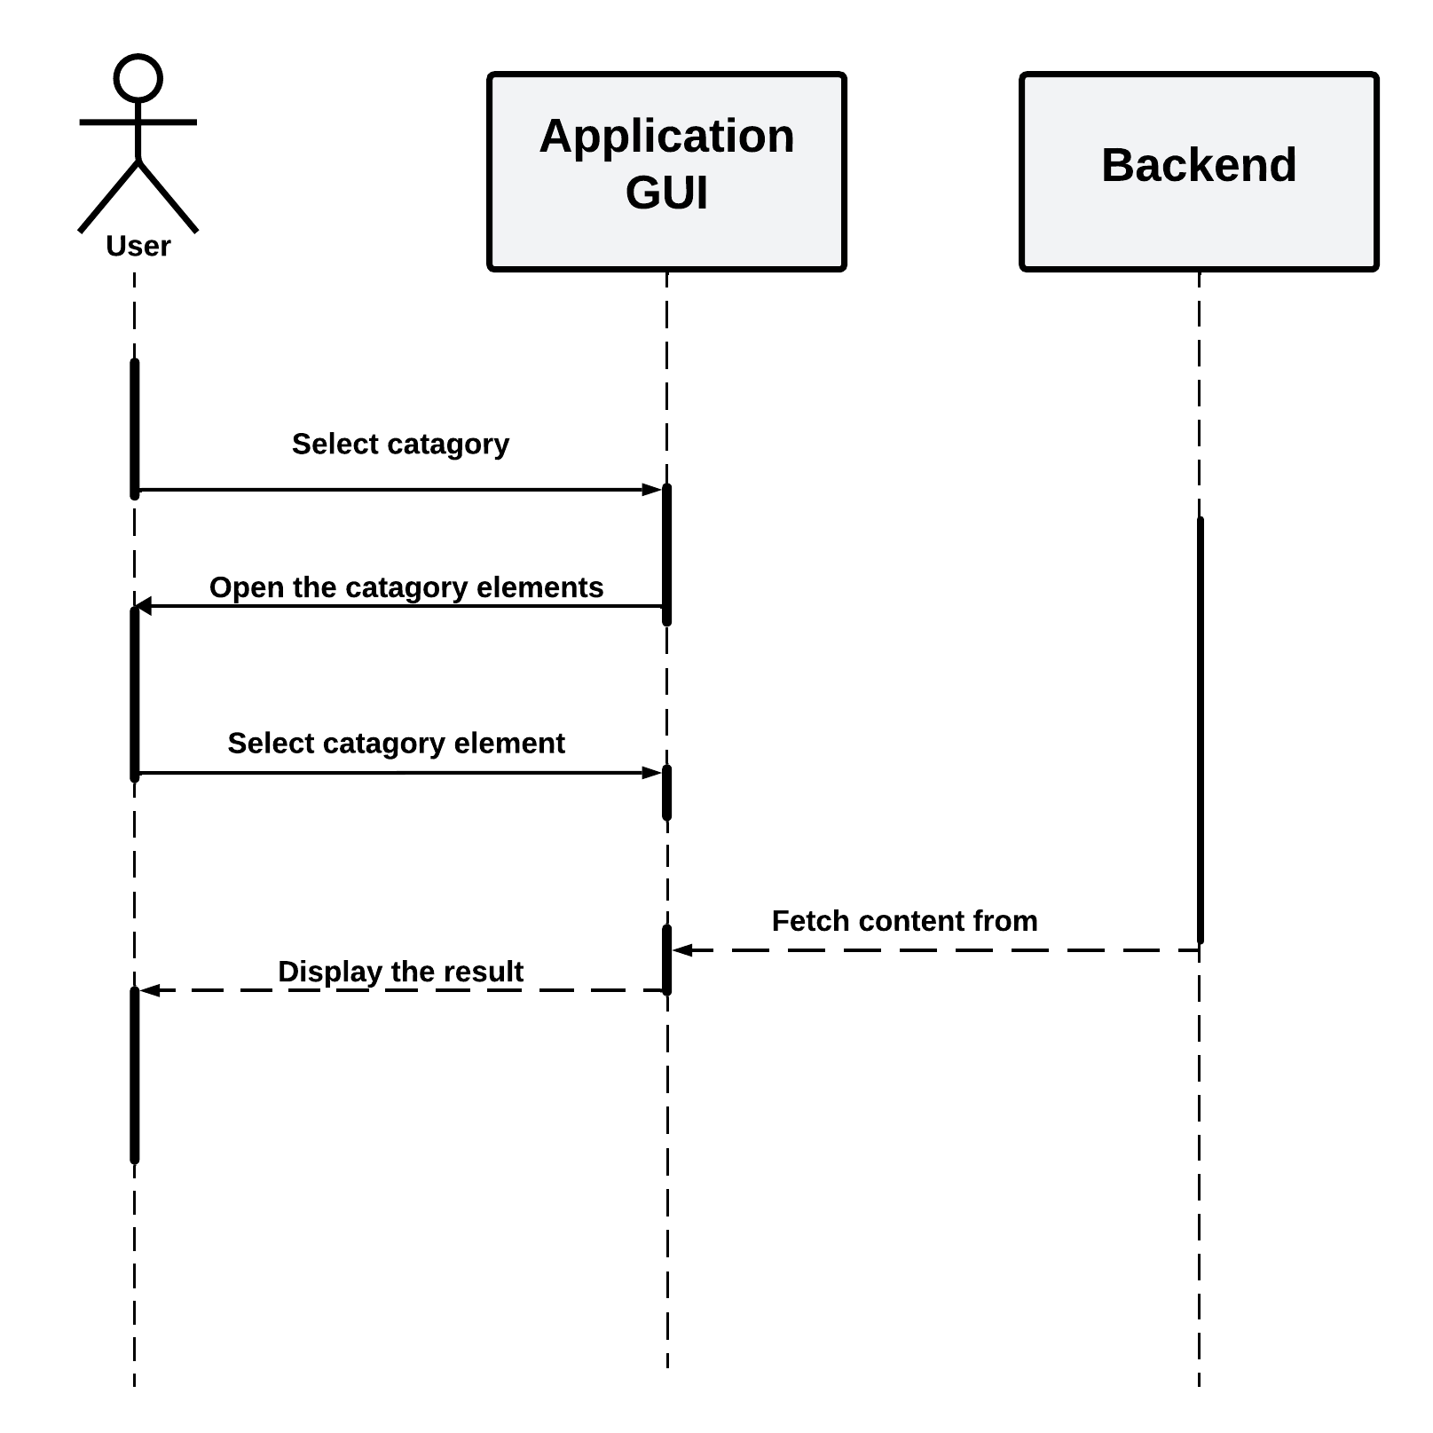
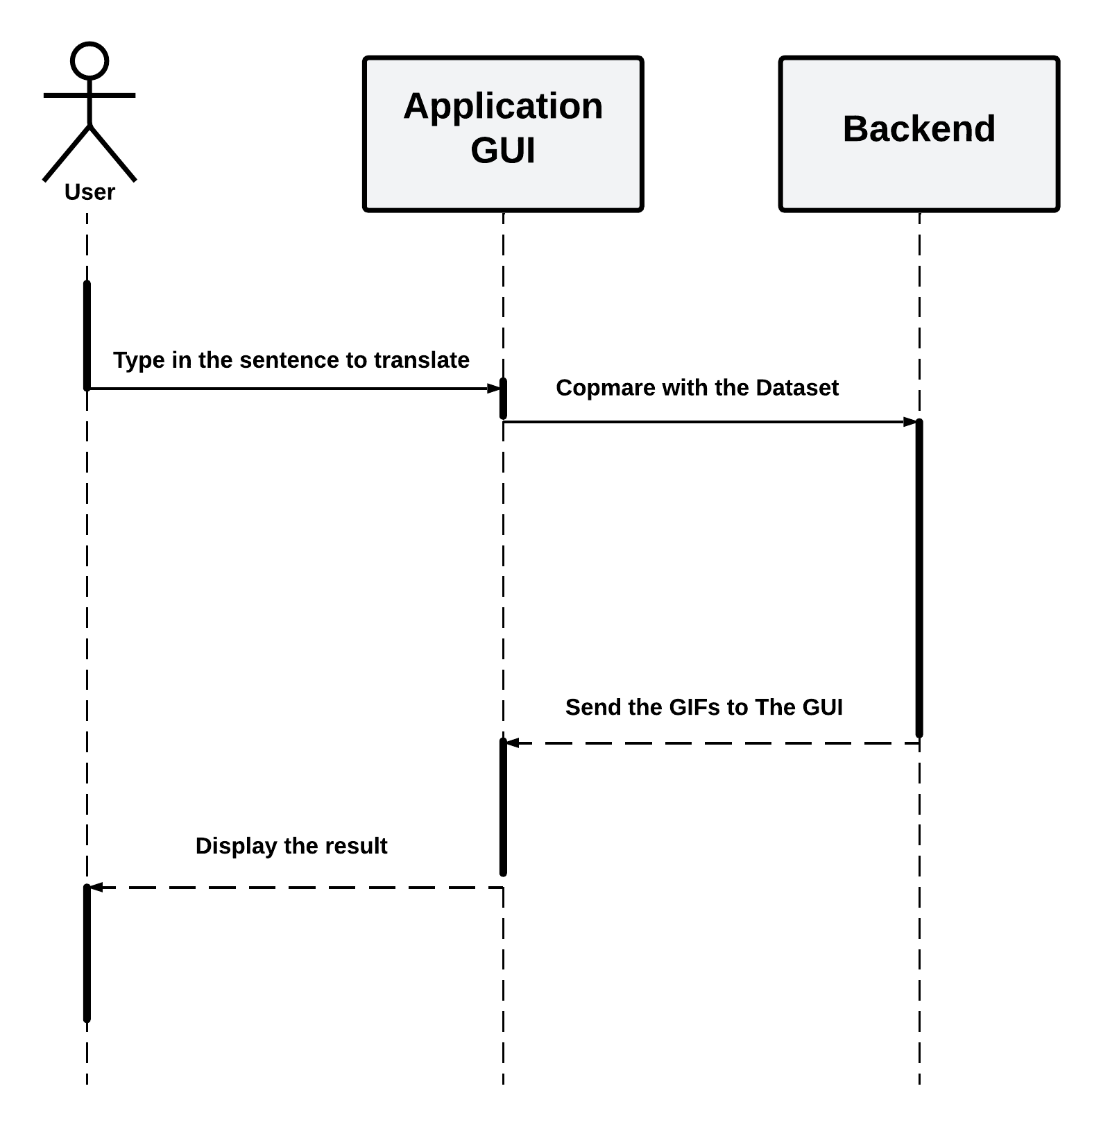
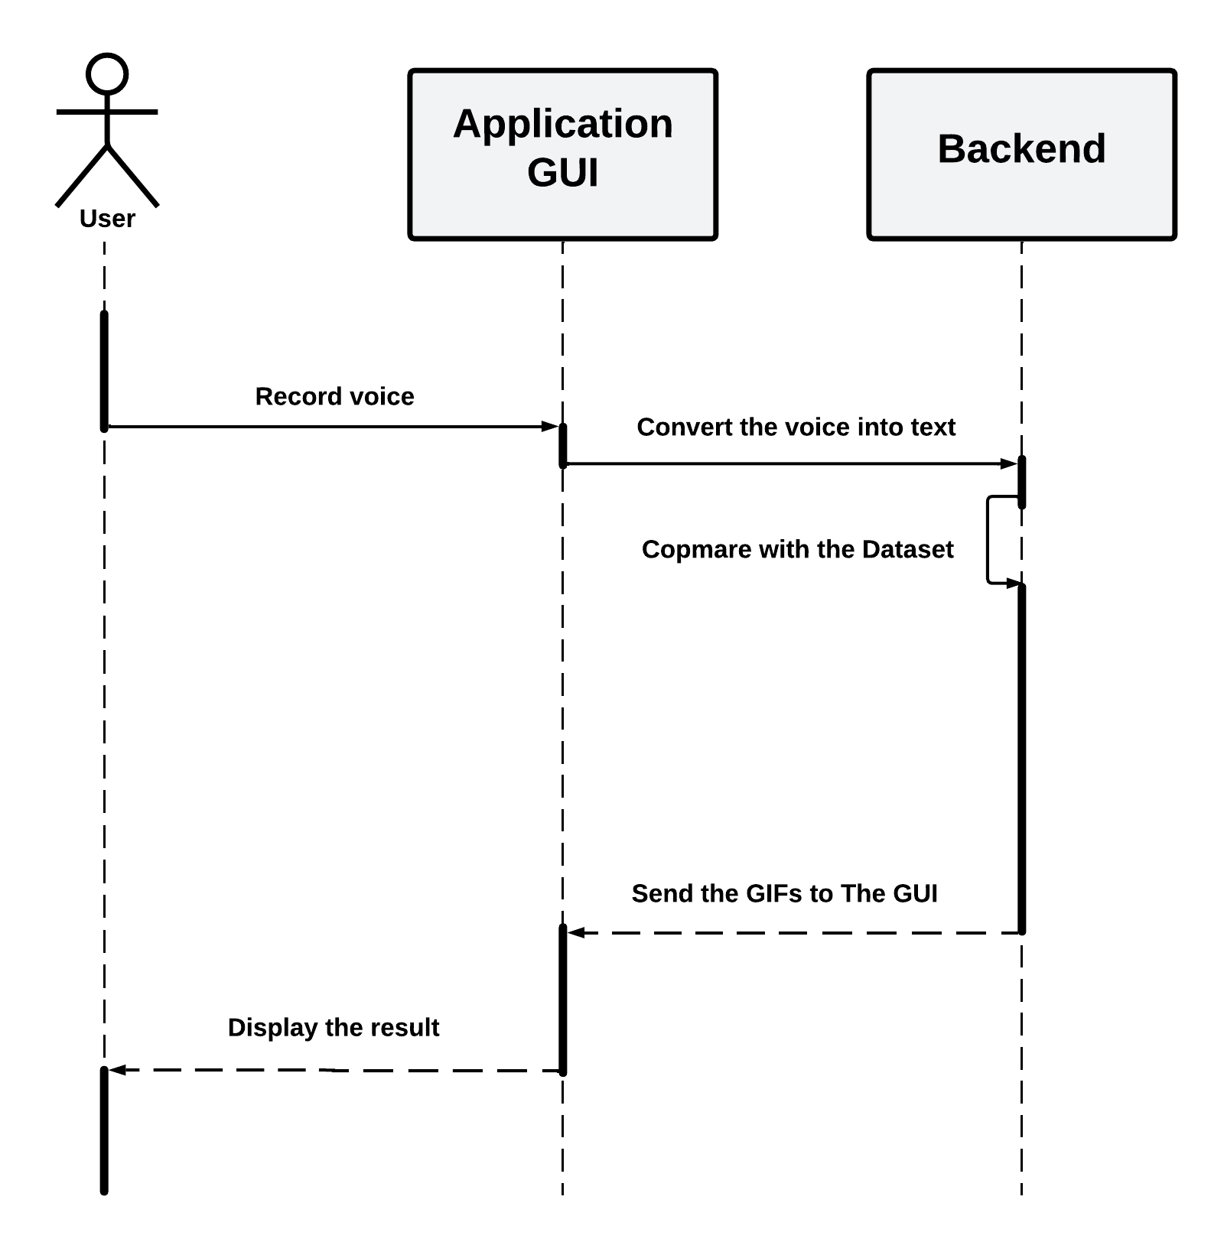
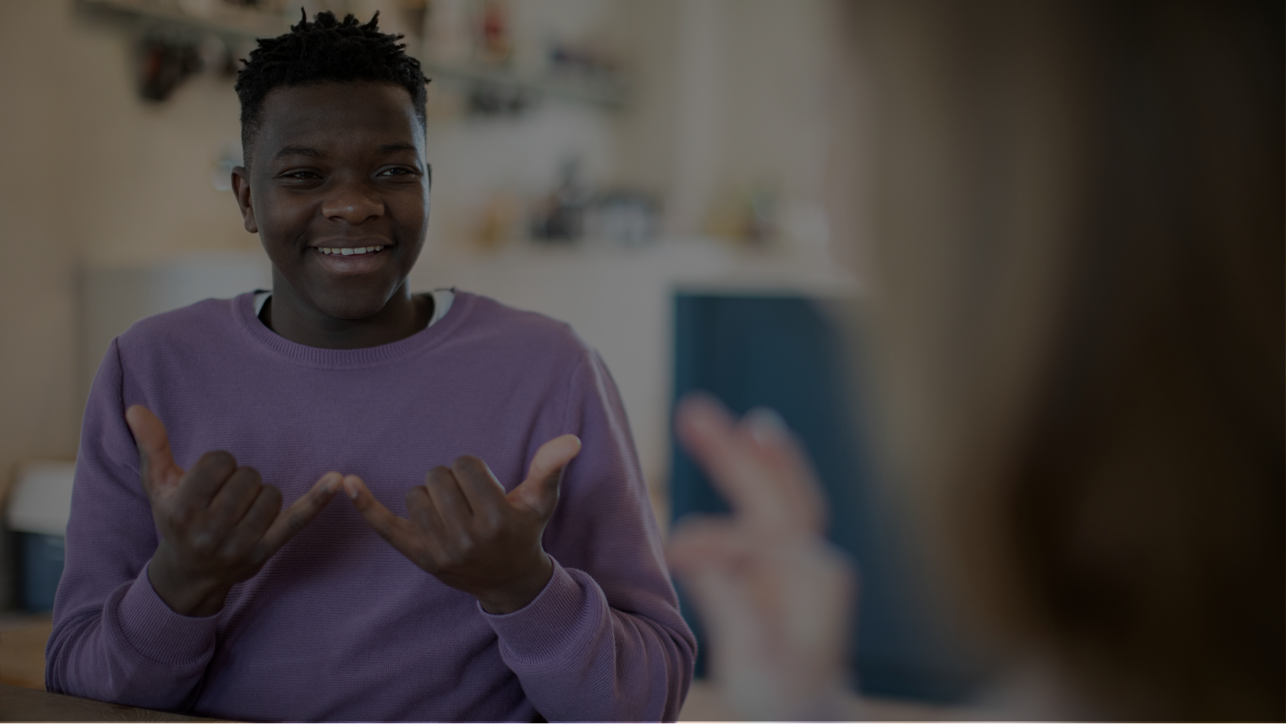
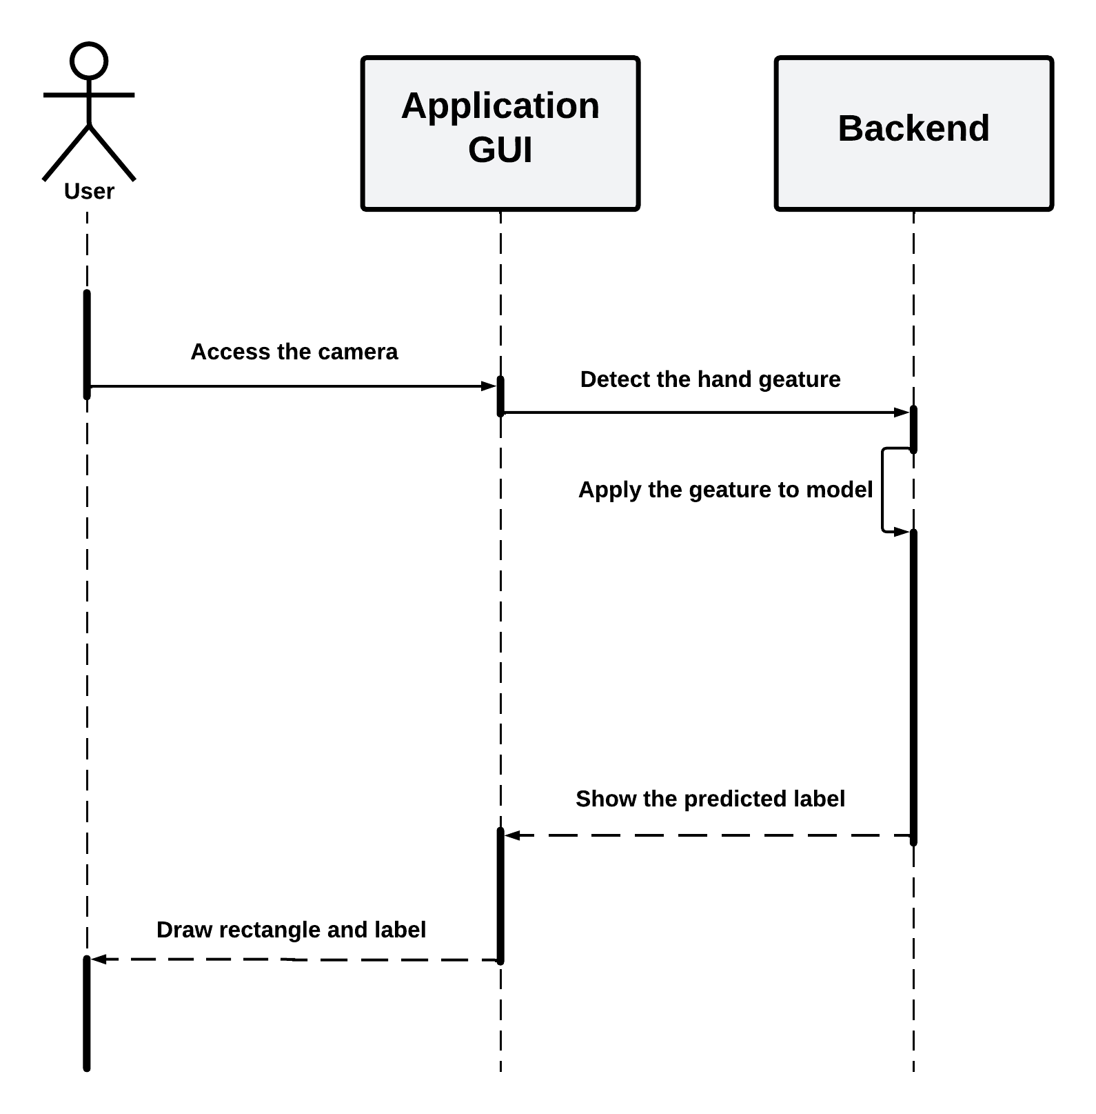
Conceptual Diagrams
Real-time functionality

Slide 13
Conceptual Diagrams
Text/voice to ArSL functionality

Slide 14
Conceptual Diagrams
Dictionary functionality

Slide 15
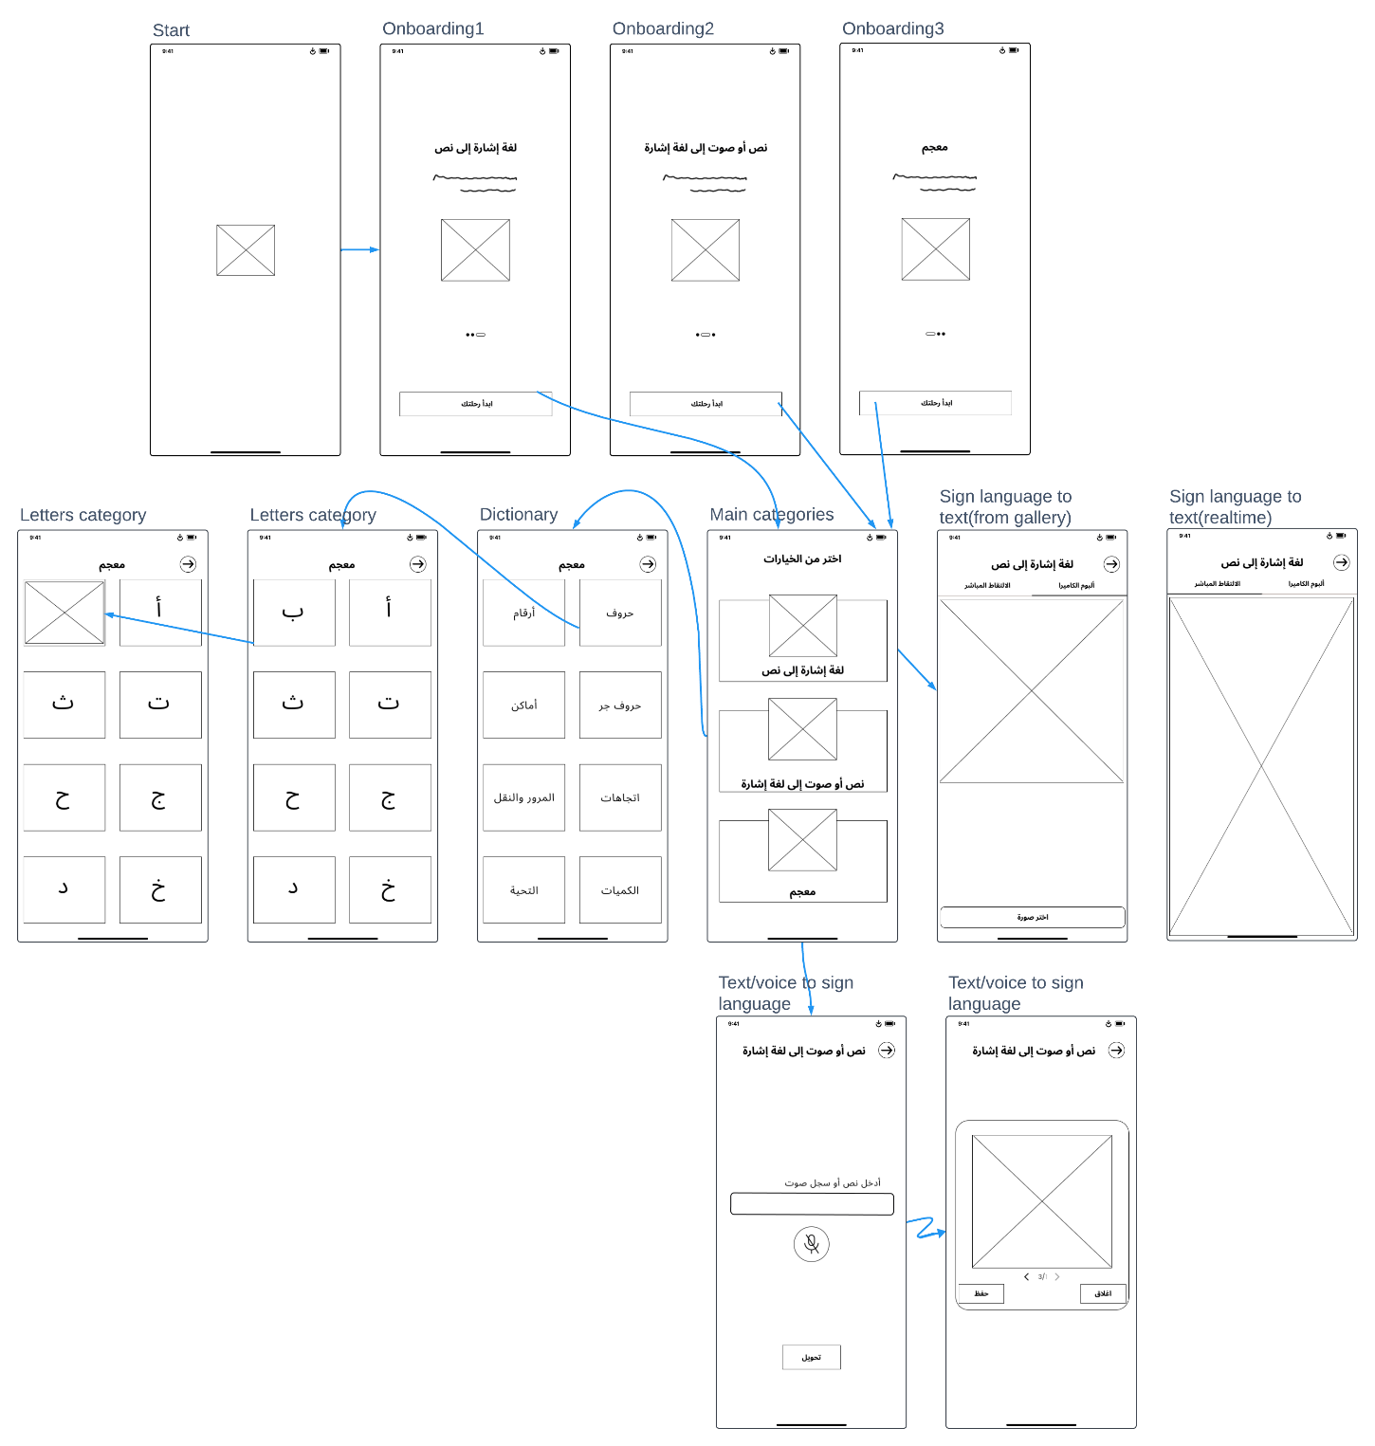
Prototype
“User Experience Design”

Slide 16
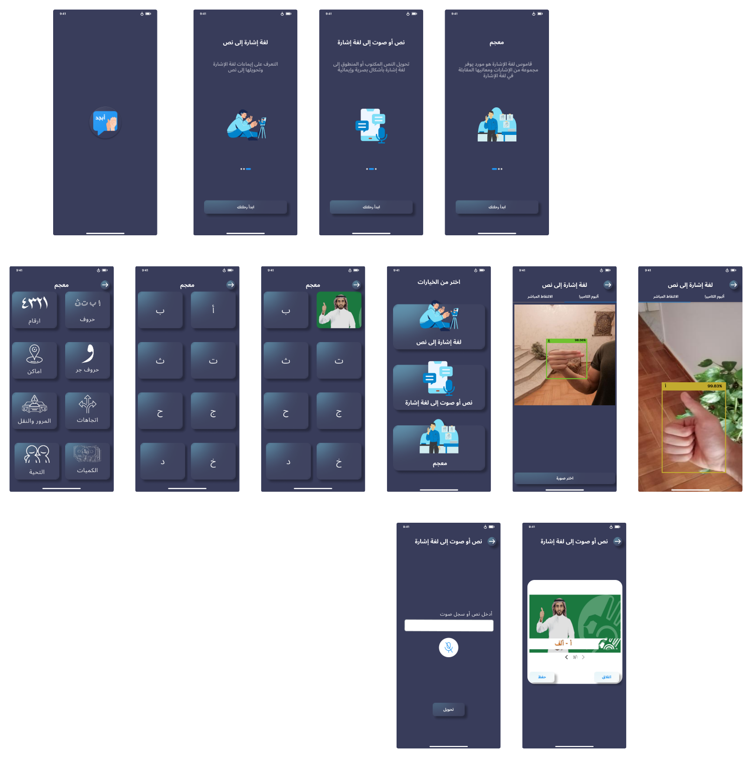
Prototype
ArSL to text
“User Interface Design”
Dictionary
Text/voice to ArSL
Implementation

Slide 17
Dictionary
ArSL to text
Text/voice to ArSL
Implementation

Slide 18
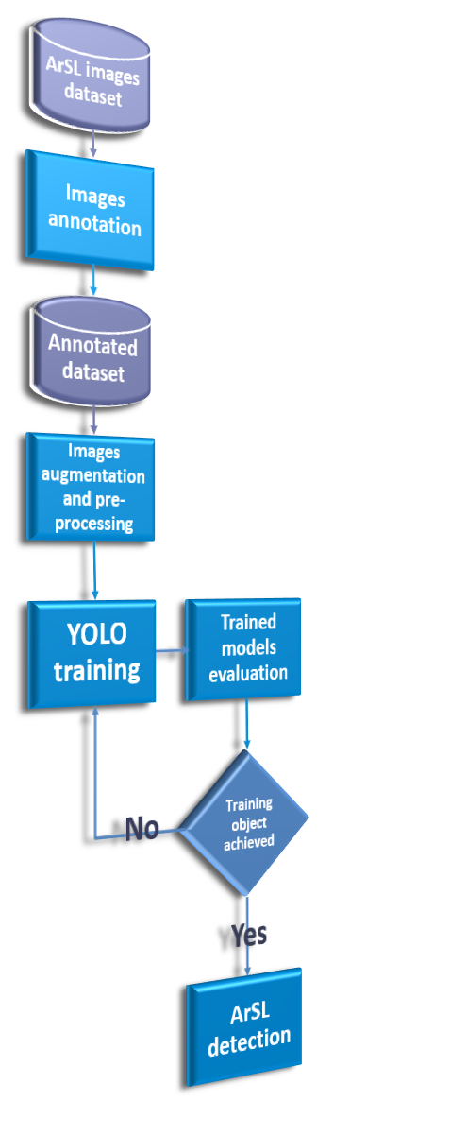
ArSL to text
Implementation
Dictionary
Text/voice to ArSL

Slide 19

ArSL to text
Implementation
Dictionary
Text/voice to ArSL

Slide 20

ArSL to text
Implementation
Dictionary
Text/voice to ArSL

Slide 21
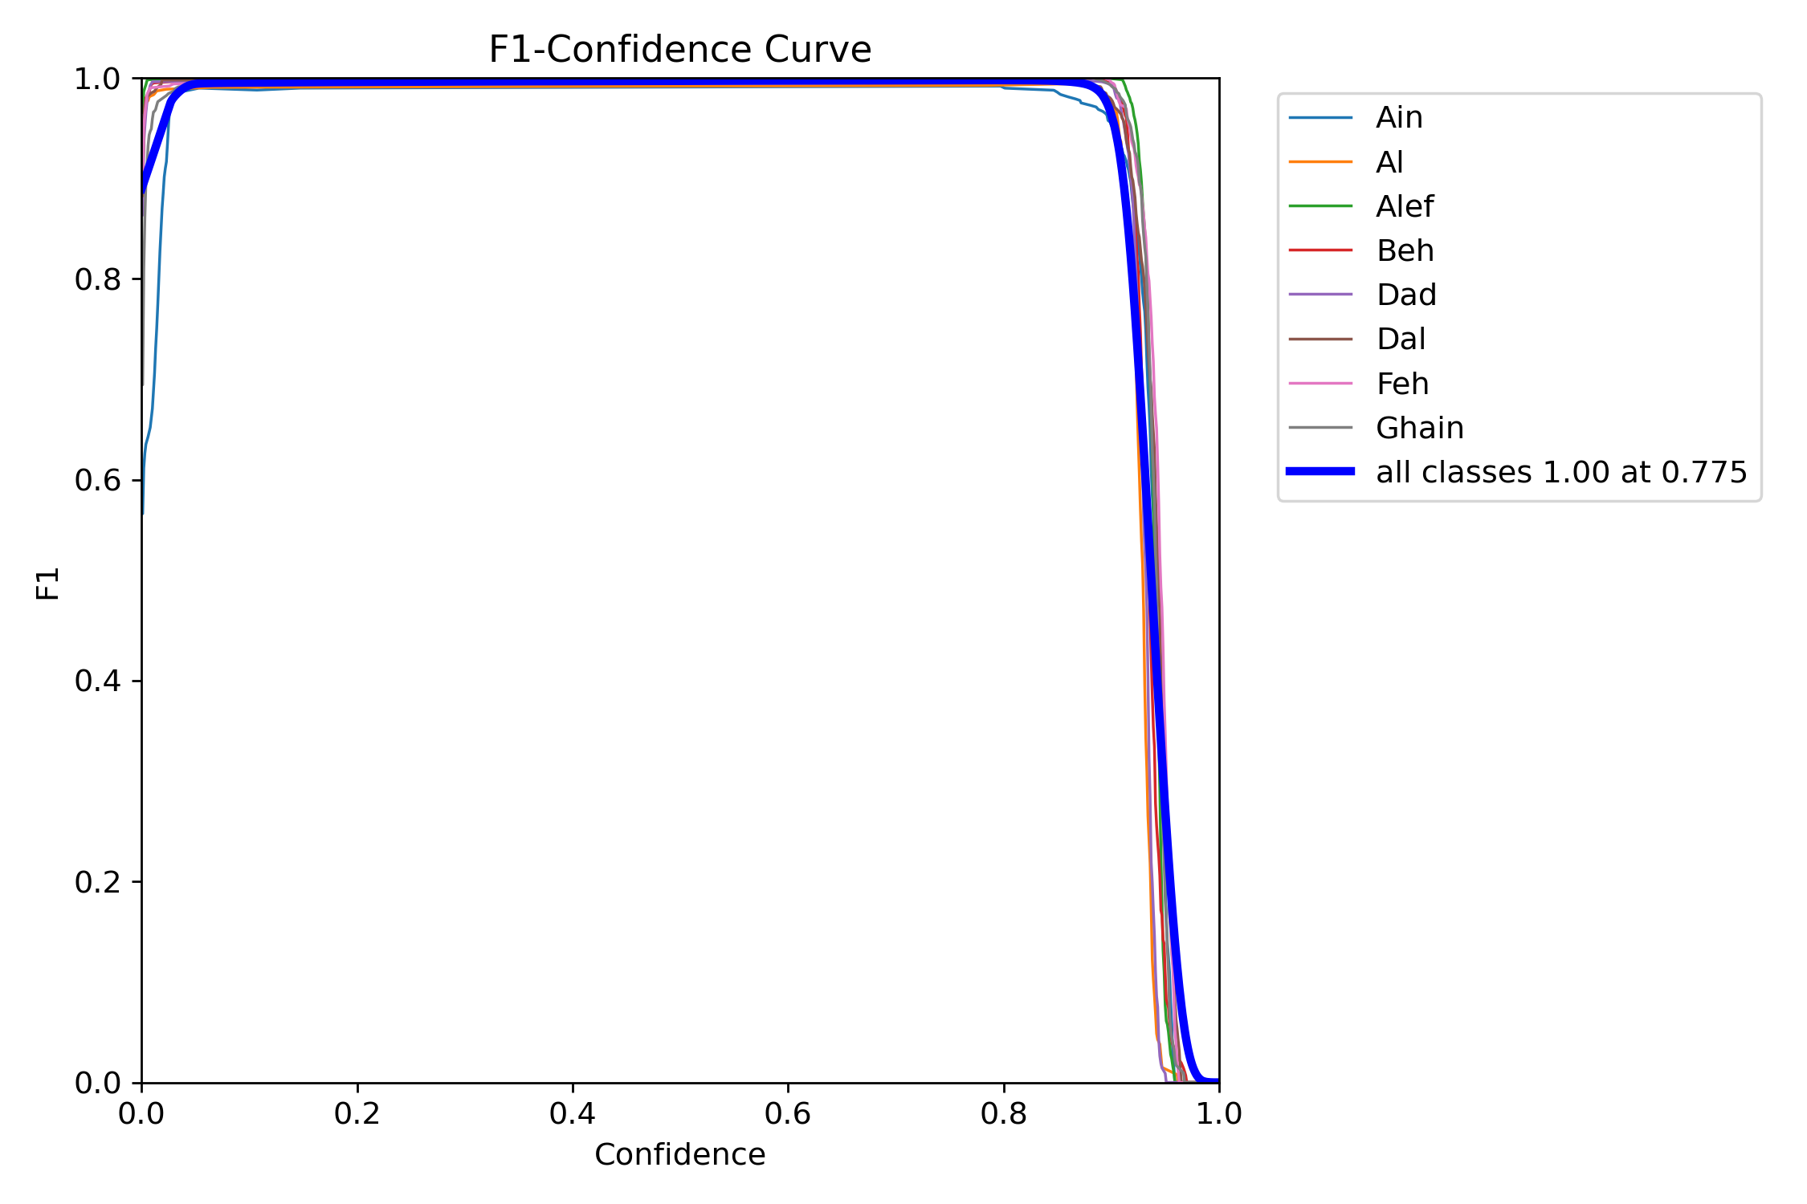
ArSL to text
Implementation
Dictionary
Text/voice to ArSL

Slide 22
ArSL to text
Implementation
Dictionary
Text/voice to ArSL

Slide 23
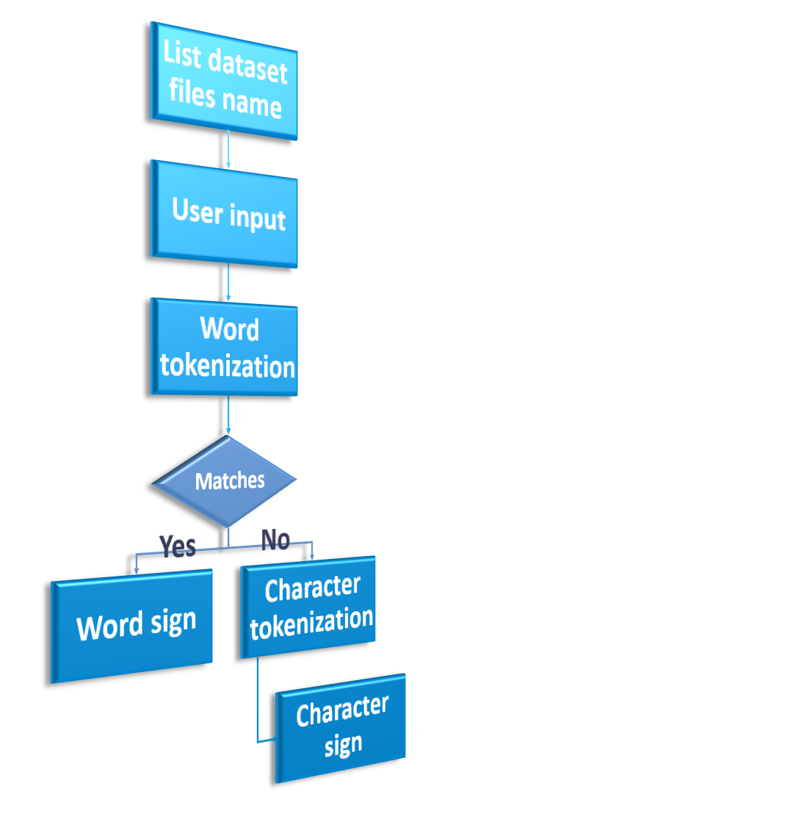
ArSL to text
Implementation
Dictionary
Text/voice to ArSL

Slide 24
ArSL to text
Implementation
Dictionary
Text/voice to ArSL
لغة الإشارة العربية

Slide 25
ArSL to text
Implementation
Dictionary
Text/voice to ArSL
لغة الإشارة العربية
مطابقة
طبيعية

Slide 26
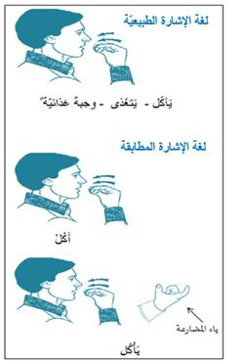
ArSL to text
Implementation
Dictionary
Text/voice to ArSL
لغة الإشارة العربية
مطابقة
طبيعية

Slide 27
ArSL to text
Implementation
Dictionary
Text/voice to ArSL
لغة الإشارة العربية
مطابقة
طبيعية

Slide 28
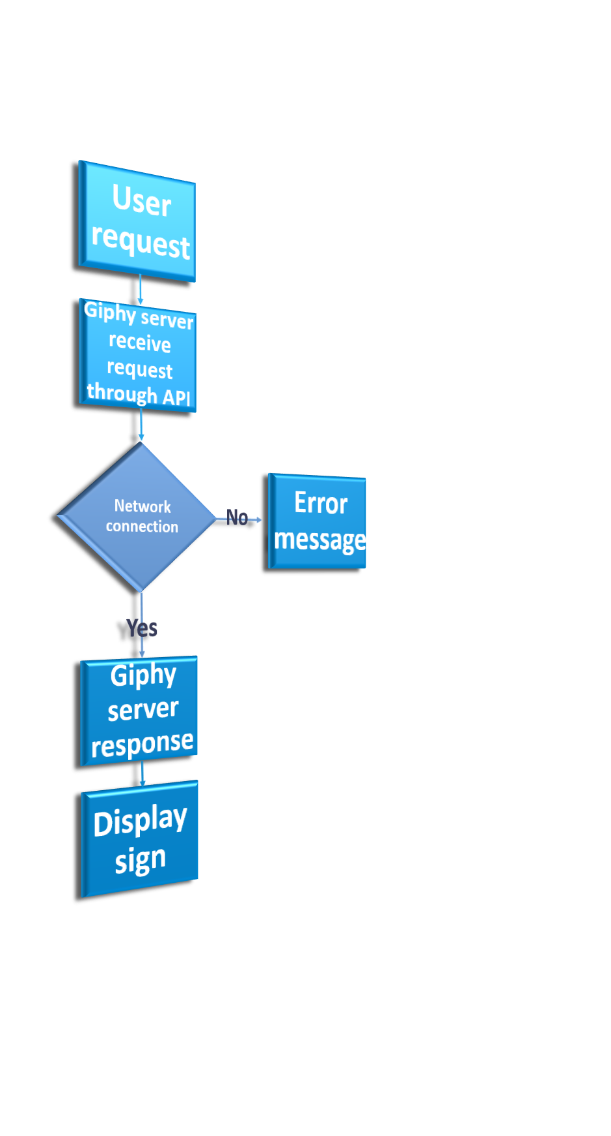
ArSL to text
Implementation
Dictionary
Text/voice to ArSL

Slide 29

ArSL to text
Implementation
Text/voice to ArSL
Dictionary

Slide 30

ArSL to text
Implementation
Text/voice to ArSL
Dictionary

Slide 31

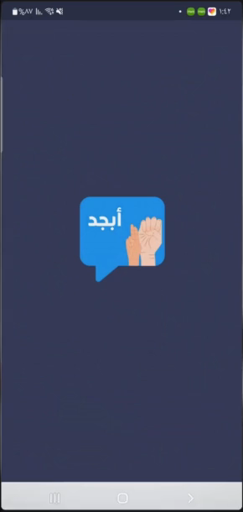
ArSL to text
Implementation
Text/voice to ArSL
Dictionary
Application
Demonstration

Slide 32



ArSL to text
Implementation
Text/voice to ArSL
Application
Demonstration
Dictionary
Transition to a GPU-based model for gesture recognition
Future work
Publish the application on Google Play stores

Slide 33
Application
Demonstration
Transition to a GPU-based model for gesture recognition
Future work
Publish the application on Google Play stores

Slide 34
Transition to a GPU-based model for gesture recognition
Future work
Publish the application on Google Play stores

Slide 35
Transition to a GPU-based model for gesture recognition
Sign languages are visual languages that utilize hand movements as a means of communication. They play a crucial role in facilitating communication for individuals with disabilities. Sign languages enable these individuals to express themselves, convey their emotions, and connect with others. However, a significant limitation arises from the fact that not everyone possesses knowledge of sign languages, which hampers effective communication. To address this limitation, the development of automated Sign Language Recognition (SLR) systems becomes essential.
Future work
Conclusion
Publish the application on Google Play stores

Slide 36
Transition to a GPU-based model for gesture recognition
Sign languages are visual languages that utilize hand movements as a means of communication. They play a crucial role in facilitating communication for individuals with disabilities. Sign languages enable these individuals to express themselves, convey their emotions, and connect with others. However, a significant limitation arises from the fact that not everyone possesses knowledge of sign languages, which hampers effective communication. To address this limitation, the development of automated Sign Language Recognition (SLR) systems becomes essential.
Future work
Conclusion
Publish the application on Google Play stores

Slide 37


